Slide 1

Team RAM
Victoria Gordon, Jasmine Ward, Januavia Anthony, Kaprice Welsh, Sameer Doshi, Dave Upton
9/25/2021

Slide 2

Hack4Equity
African American woman in rural GA gets pregnant......
The lack of access to high quality, evidence based maternity health care services in 129 rural counties in Georgia that is associated with increased rates of maternal mortality and morbidity, disproportionately affecting African American Women.
Notes:
Step One Pain Points:
She may not have insurance
There may not be a doctor in her community that does pregnancy care
She may not have transportation
She may not be able to take time off of work
she may not have childcare
She may not receive early or adequate prenatal care
She may not get quality counseling and education
Step Two
Woman in Rural GA experiences complications that affect her pregnancy
Pain points
Specialized care not available she is unable to access an MFM
She is unable to be compliant with visits due to aforementioned factors
She drops into her local ER frequently
Step Three
Woman in Rural GA experiences adverse outcomes in her pregnancy
Local hospital may not have the training, personnel or facilities to manage OB emergencies
Lack of early intervention makes the situation even more deleterious.
It's too late to be preventative.
Maybe unassigned

Slide 3
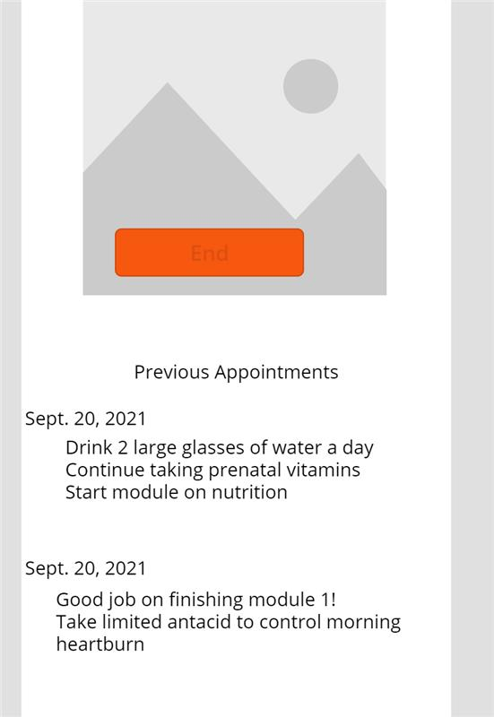
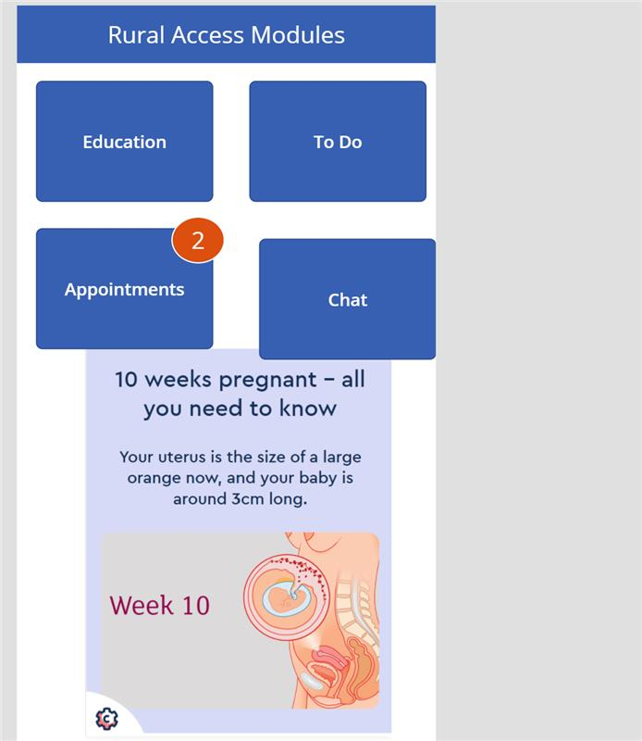
Rural Access Model
Hybrid Prenatal Model of Care
Notes:
RAM Model of care is a hybrid between an online learning platform and a telemedicine/ telemonitoring enabled, EMR system. Bringing complete and comprehensive prenatal care from the remote providers office to the womans fingertips, through a cell phone app.
Functioning similar to a online learning experience, the prenatal care experience is interactive, patient centered and multidimensional. Being enrolled in the program by their provider, the patient signs into their app, and watches educational videos regarding fetal development, nutrition, exercise, listen to recorded informational messages from their provider regarding their lab results and upcoming tests, take self administered symptom check list and record their vital signs, weight and even their fetal heart tones!
Through the app, the client can self schedule a telemedicine or in person appointment, message directly with their provider, view all their labs and results and visit notes.
Providers can create assignments for their patients such as upload a food journal, complete a kick count form, submit a birthing plan and send reminders for upcoming appointments and other care plan specific items. It is completely customizable to the patient's specific needs.
This doesn't completely replace in person visits, but it decreases the number of visits by half and increases the quality of the care being provided!

Slide 4




How is this different than telemedicine? Higher Quality Product
Benefits | RAM | Telemedicine | Telemonitoring | In Person Prenatal Care
Intuitive to Use
Interactive
Comprehensive
Cost Effective
Readily Available
Multidimensional
Notes:
Intuitive to Use, think of our younger generation that is much more tech savvy than previous generations, prefer electronic communications
Interactive, in that it REQUIRES input from the patient, generates participation through "quizzes" and "exams" teach back method
Comprehensive, includes either synchronously or asynchronously ALL of the components in a typical prenatal visit, objective data gathering, subjective data gathering, ordering of the appropriate tests as well as enhanced patient education and counseling.
Cost Effective EMR, telemedicine and telemonitoring software are proven to be cost effective for the provider, through a hybrid model of care, the patient in rural GA saves on their cost as well.
Readily Available for both provider and patient. She can access her records and education at any time. She can watch recorded messages from her provider, submit required data and assignments on HER schedule.
Multidimensional allows for other clinicians and health workers to access the patient and for the patient to access them. So if she has an MFM on board, a community health worker, a doula or cardiologist they can also access this patient and she can access them.

Slide 5
Equal Access, to High Quality Maternity Care

